Slide 1

Automating the Alfresco Taxonomy
Jason Jolley

Slide 2

The Basics
A ‘Taxonomy’ is a Classification Scheme.
Think ‘Blueprint’ for your data.
Folder Structure
Metadata
Tags
Categories

Slide 3
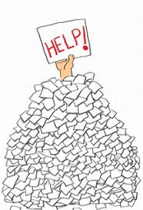
Why Automate?
Consistent Data and Structure is important!
Users hate creating structure and data
Users love structure and data for retrieval!
Site: Cases
> Folder: <Case Status>
> Folder: <Case>
> Folder: <Document Type>
> Folder: <Document Sub Type>

Slide 4


DataList Backed Content Fields
Why?
Empower Your User Community!
Keeps Data Consistent & Valid

Slide 5
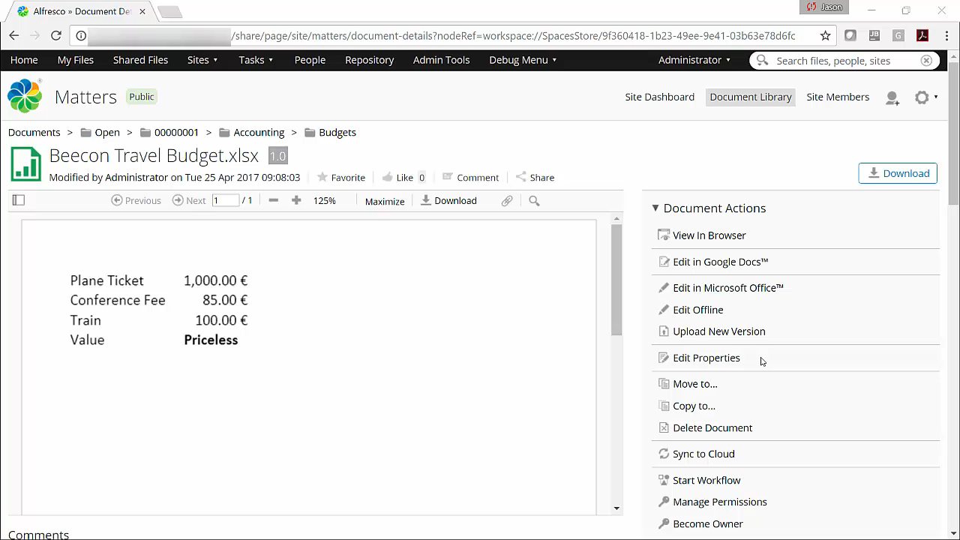
Data List Backed Content Fields – Slide 1

Slide 6
How to do this?
Create a Datalist
Create a Webscript that can get results of a Datalist
Create a Share renderer control to display that data

Slide 7



Metadata Inheritance
Why?

Slide 8
Metadata
Two types of Metadata Inheritance
On Creation
On Folder Update

Slide 9
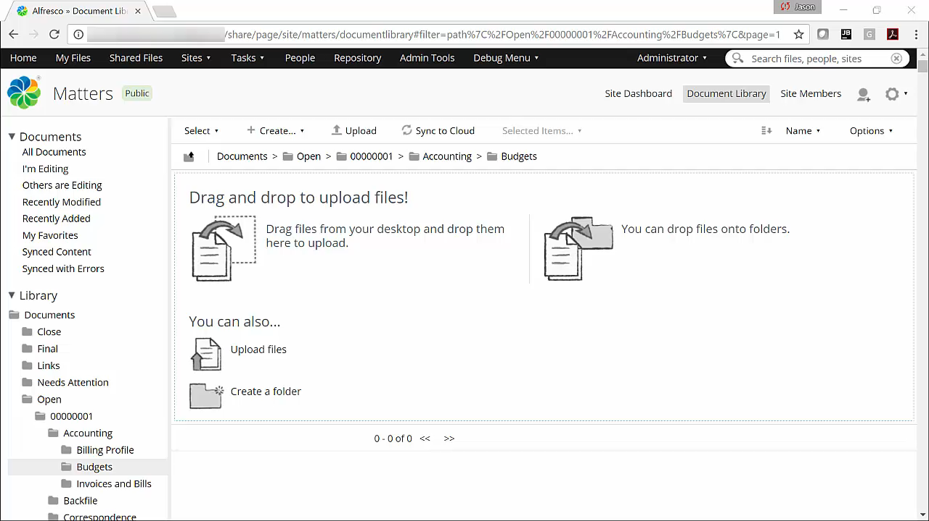
Metadata Inheritance - Slide 1

Slide 10



Q: How was this done? A: Alfresco Rules!
Simple
+
Rules
Complex
+
Rules

Slide 11
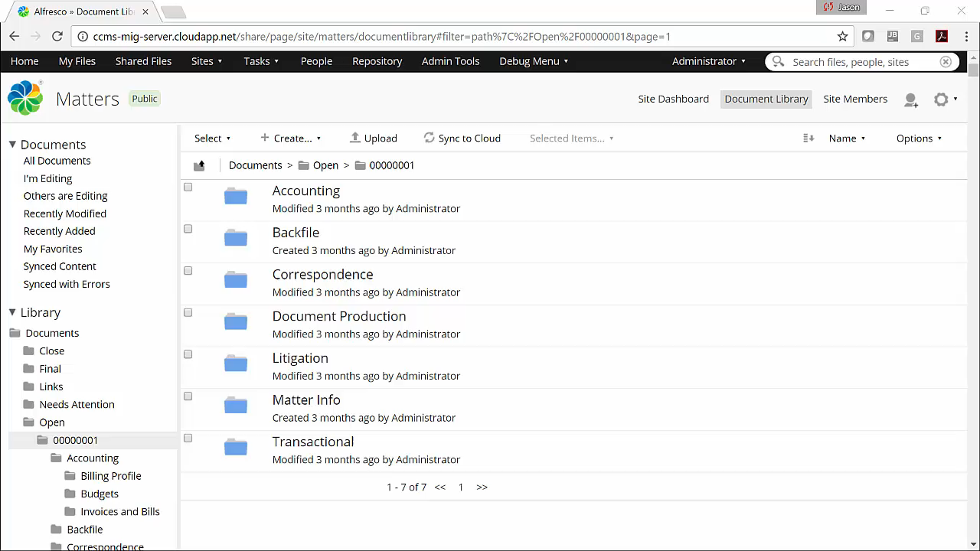
Metadata Inheritance - Slide 2

Slide 12

Q: How was this done? A: Alfresco Rules!
A Little More Complex
+
Rules
Modified / Created Info:
Disable Behaviour for updating system info.
Checked Out Documents!
Cancel & Re-Checkout

Slide 13
Q: How was this done? A: Alfresco Rules!
A Little More Complex
+
Rules
Modified / Created Info:
Disable Behaviour for updating system info.
Checked Out Documents!
Cancel & Re-Checkout

Slide 14
Site Creation
Q: How do you do it? A: Emulate Share via REST
Use Browser Tools to interrogate Share (Warning: There are minor differences between Alfresco versión)
Go to User Dashboard
Login (if necessary)
Create Site
Go to Site Dashboard (to initialize Site)

Slide 15
Site Creation
Q: How do you do it? A: Emulate Share via REST
Use Browser Tools to interrogate Share (Warning: There are minor differences between Alfresco versión)
Go to User Dashboard
Login (if necessary)
Create Site
Go to Site Dashboard (to initialize Site)
Example:
{
// Site Creation Properties
"sitePreset":"site-dashboard",
"title":"Test Site",
"shortName":"test-site",
"description":"",
"visibility":"PUBLIC“
}

Slide 16

Common reason to create sites by API?
External Processes (Think Authoritative Data Sources)
Workflow (Use Activiti and REST Call Task)
Document Intake / Taxonomy Creation using Rules

Slide 17
Jason Jolley
jjolley@microstrat.com
@jasonjolley

